Slide 1
Build a killer Fantasy Football Team with Power BI

Slide 2








SQL Saturday New York City 2023
Thanks to the sponsors and organisers
Platinum
Gold
Bronze

Slide 3

Session Feedback

Slide 4


About me
Gethyn Ellis
Microsoft, Azure, Power Platform Trainer
www.gethynellis.com
gethyn@gethynellis.com
Twitter: @gethyn_ellis
LinkedIn: https://www.linkedin.com/in/gethynellis/

Slide 5
What is Fantasy Football
Pick a Squad
Stick to a budget
Manage your squad
Transfers
Scoring

Slide 6

What are we going to talk about
If you’re new to Power BI or just curious, about what I am going to talk about then this session is for you. We will talk about
Data sources
Loading into Power BI
Cleaning and transforming the data
Modelling the data
Adding some measures
Creating great visuals to show which players should be in our team and those that shouldn’t

Slide 7
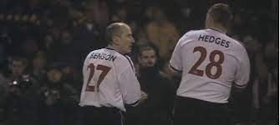

Terrible Fantasy Football Results
Berry hasn’t been very successful in previous seasons
Picks her team on a hunch
Her hunch is often wrong
She’s not on her own

Slide 8
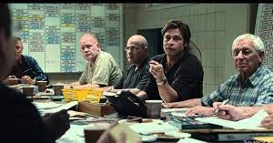


Moneyball
How do you compete when you don’t have the same resources available
Cue our hero Brad Pitt
Red Sox
Liverpool

Slide 9

Kevin De Bruyne
£83 Million contract
No agent

Slide 10

Why can’t you use data to pick a fantasy soccer team?

Slide 11
What do you need to win at FPL?
You don’t buy players
You need to buy
Goals
Assists
Clean sheets
Bonus Points

Slide 12
Data analyst skills
Berry can use her data analyst skills to
Prepare
Model
Visualise
Analyse
Manage

Slide 13

What is Power BI?

Slide 14

Power BI to the rescue
End to end analytical solution
Famous for it visualisations
Its much more than that

Slide 15
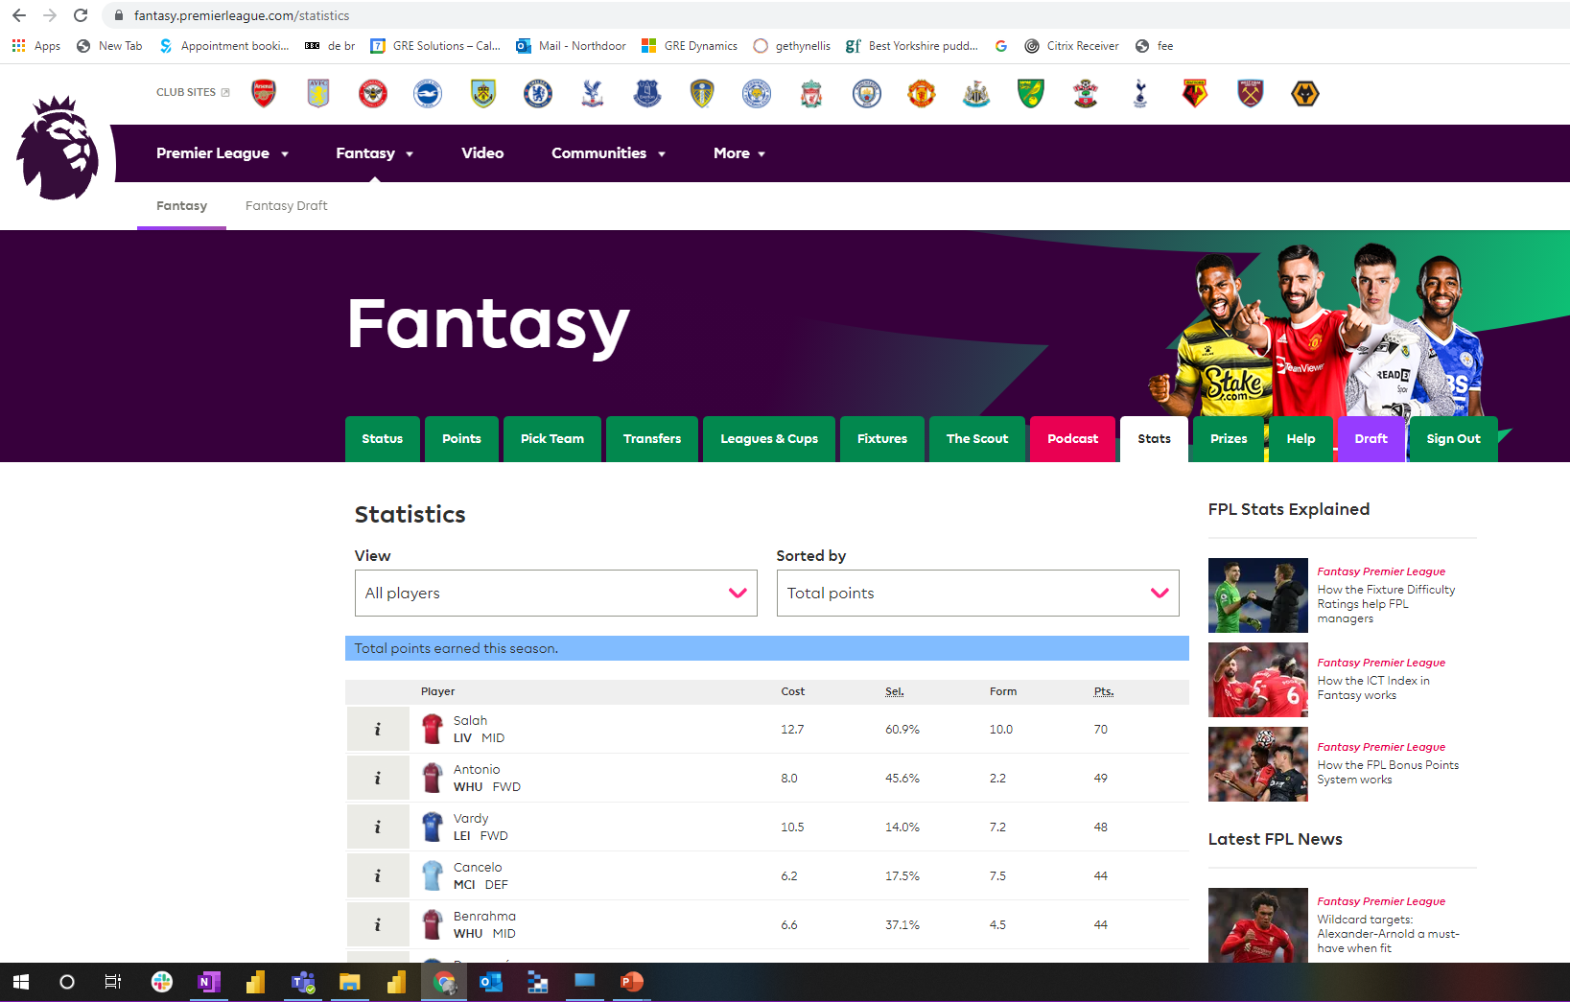
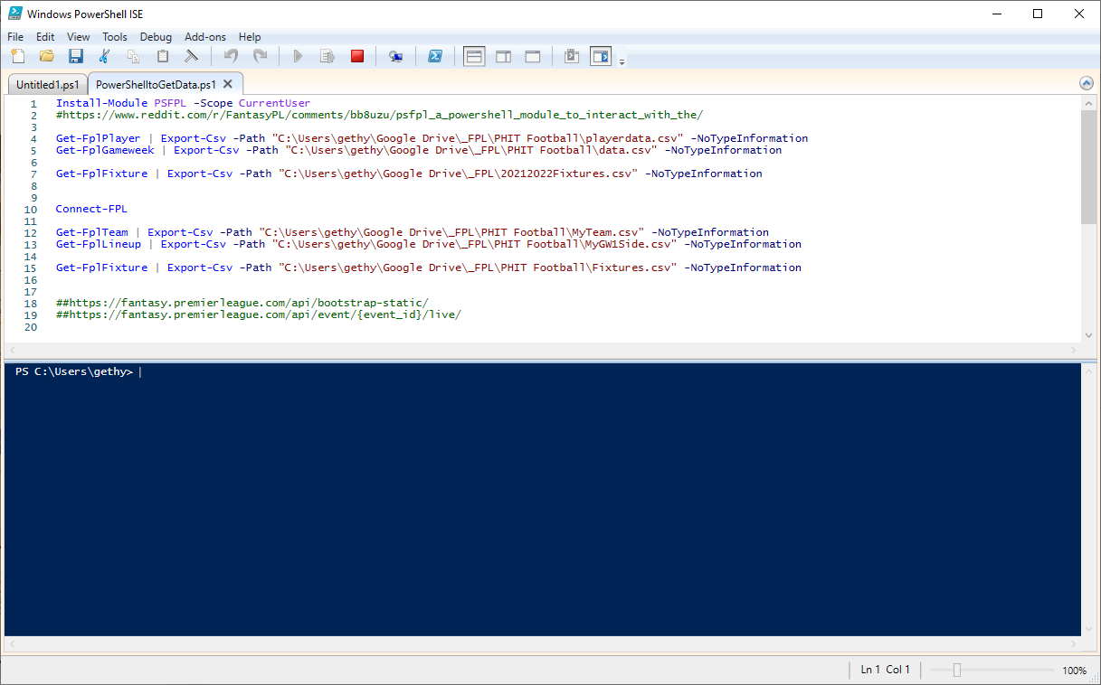
Where can I get that data?
FPL make their data available
The FPL Site
The API

Slide 16
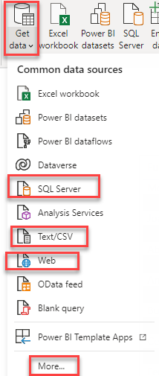
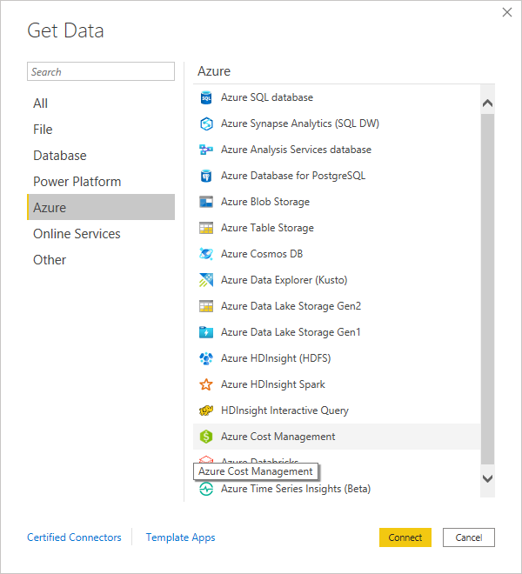
Prepare the data
Soucres you can connect to too
API
PowerShell
Clean up the data – get the correct data types

Slide 17
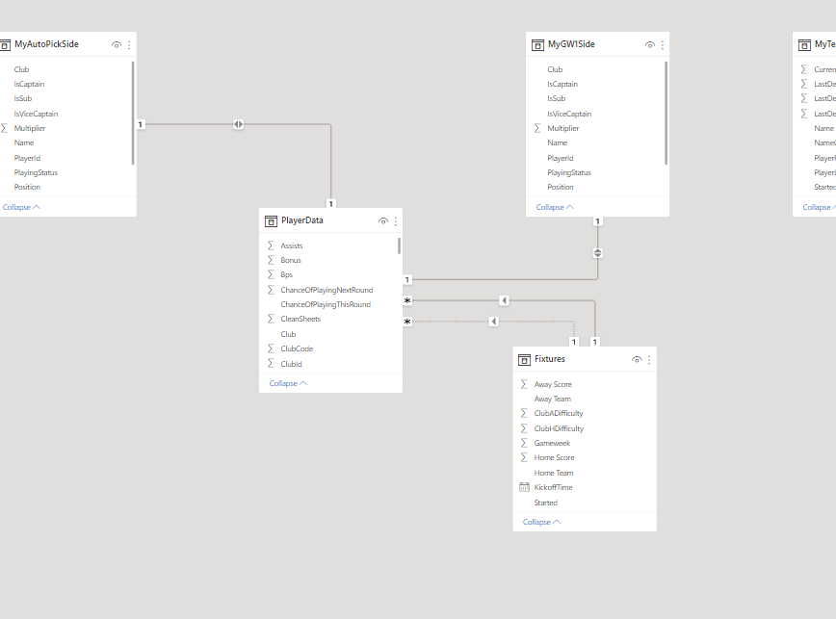
Build a model
Power BI can make use of star schema
Power BI didn’t invent the star schema
Star Schema can be useful
Fact table
Dimension table

Slide 18
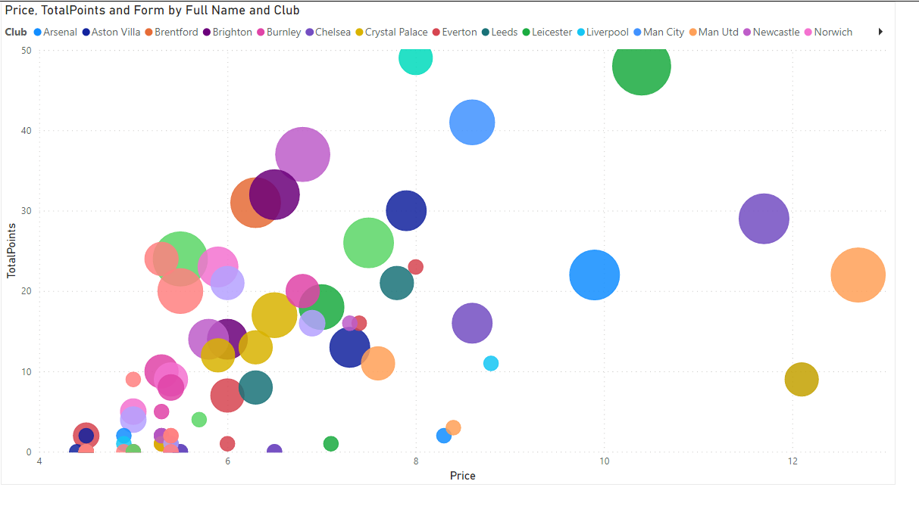
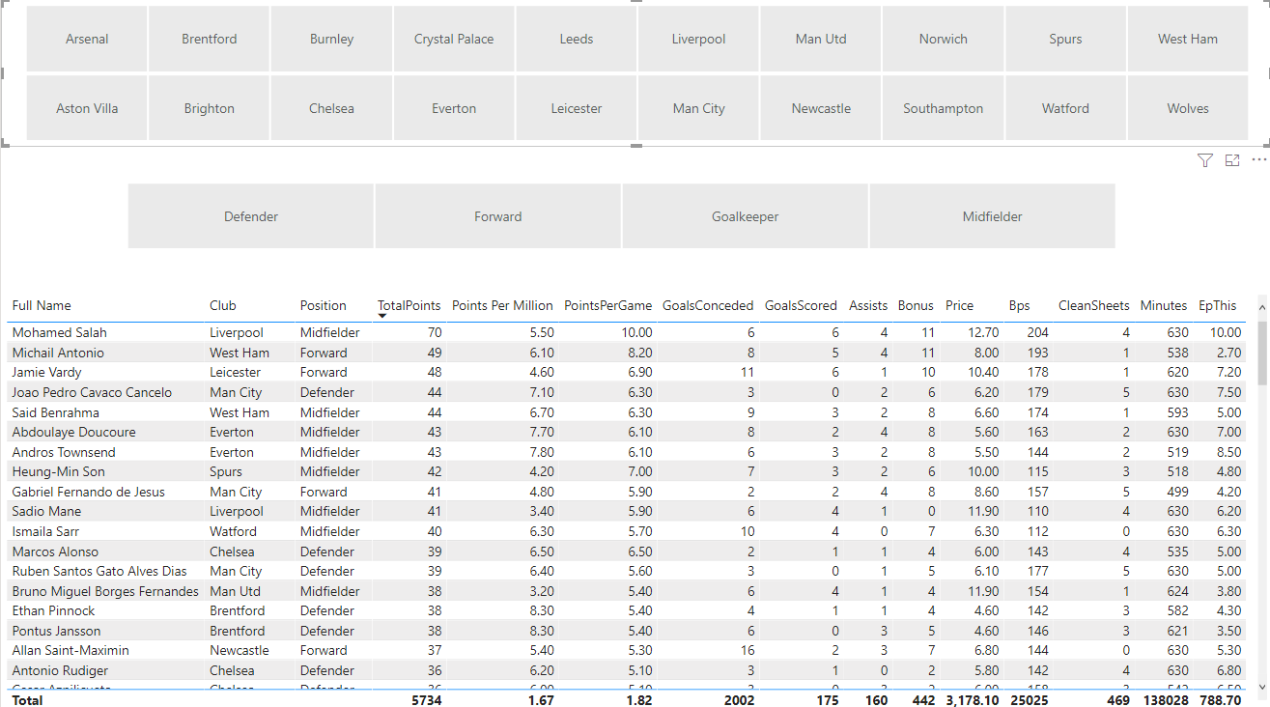
Visualize
High Value Players – Scatter Plot
Allow users to interact – Slicers

Slide 19
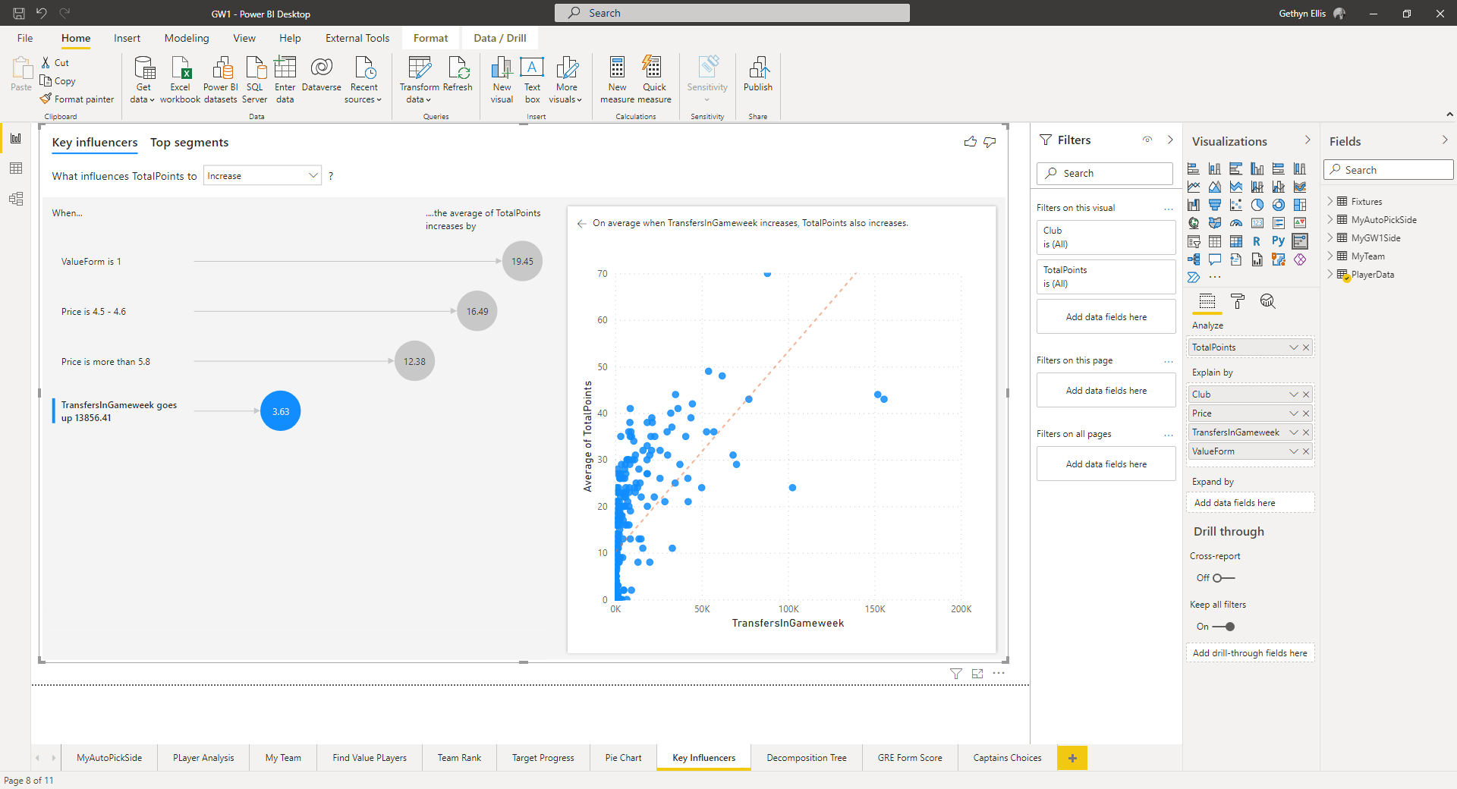
Analyse
What makes a winning team
AI Features
FPL – Magic

Slide 20
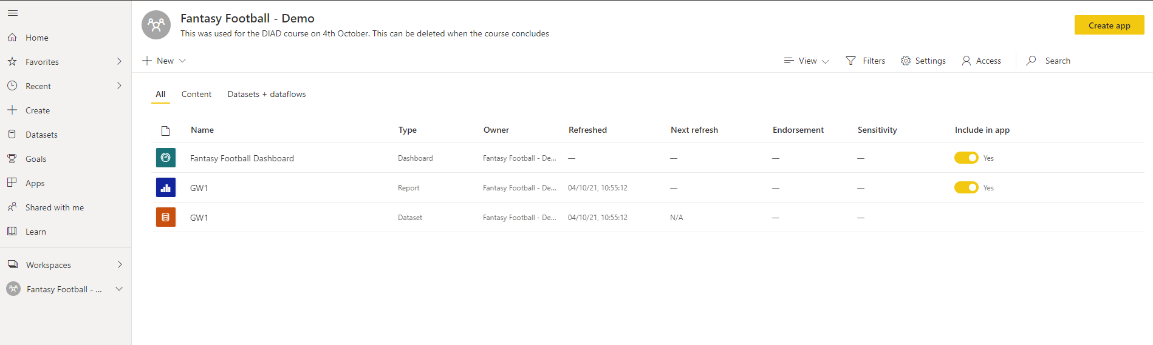
Manage
Workspaces
Embed Power BI into a webpage

Slide 21

Demo

Slide 22
Try it for your self
See if you can do better than Berry
Let me know what you do differently to me

Slide 23
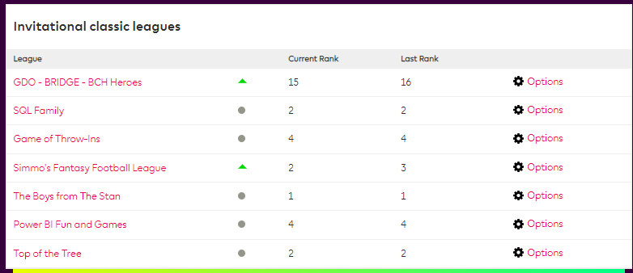
Season 2021/2022

Slide 24
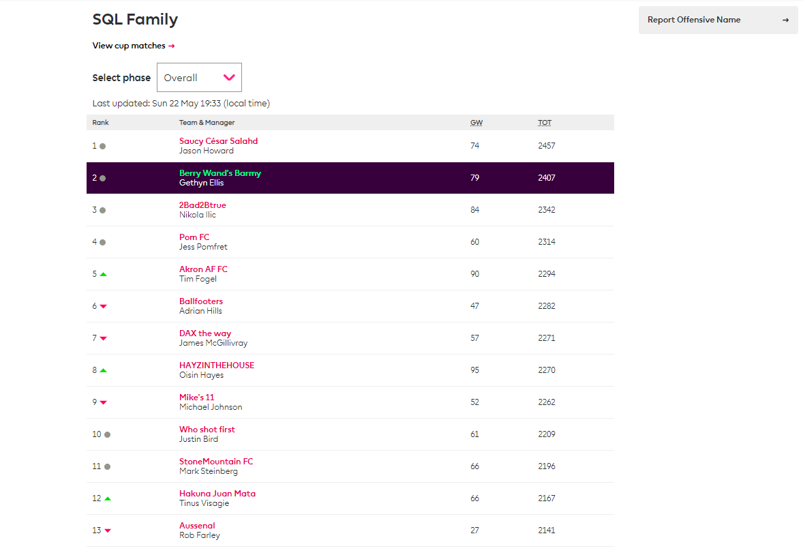
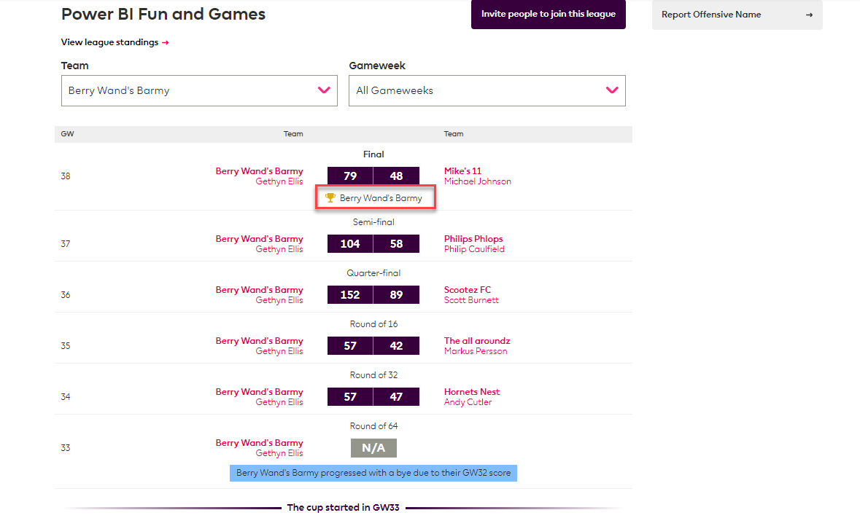
SQL Family and Power BI Fun and Games

Slide 25
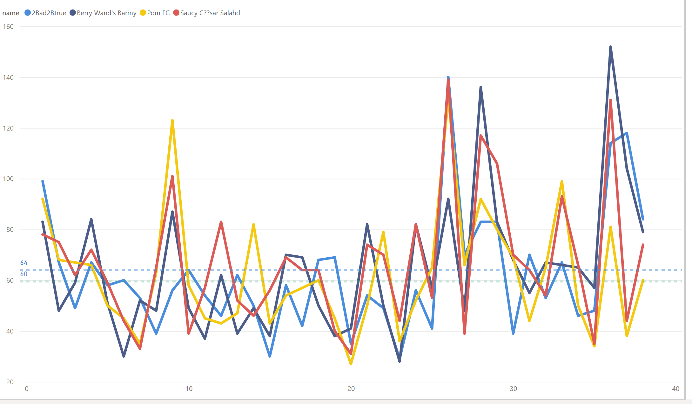
SQL Family Analysis
Week by Week analysis

Slide 26
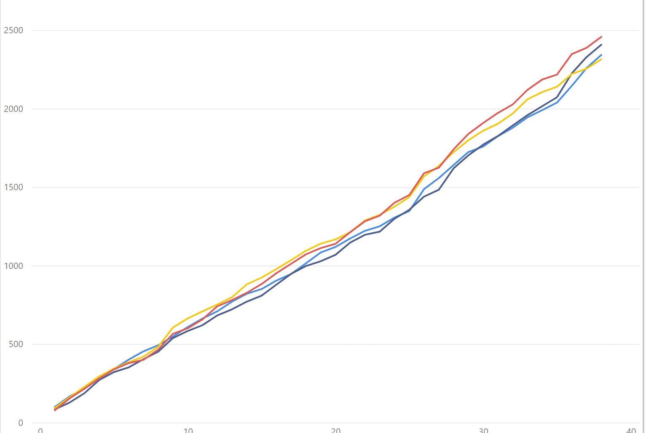
SQL Family Snake Chart

Slide 27
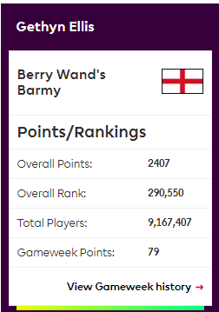
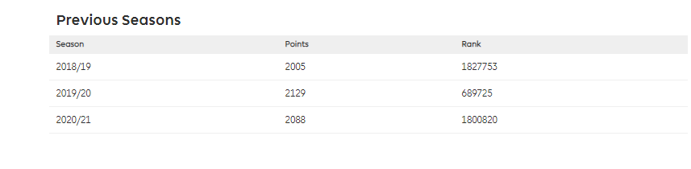
You might even win the league
Can’t promise that
Berry had her best season ever
Top 3% globally

Slide 28
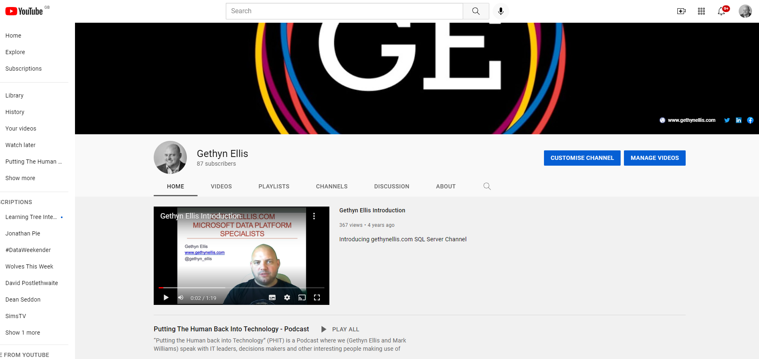
Follow us on YouTube
Keep up with our progress
Keep up with the PHIT Podcast
Look out for our free Power BI Training
Code to join this league: apdxnm

Slide 29

Questions

Slide 30
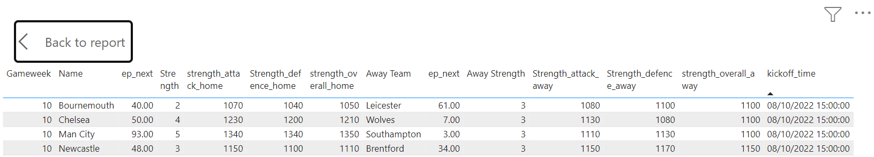
Not gambling advice

